Slide 1
ECE 6245 MICRO & NANO FABRICATION FINAL PROJECT PRESENTATION
Group 2
Meta Lens based on Phase Change Material (PCM)
Yeshwanth Reddy Katta
Chandana Nagol Kantharaj

Slide 2
ABSTRACT
This research introduces active polarization-insensitive phase-change meta lenses based on a low-loss PCM, Sb2Se3, for near-IR wavelengths. The successful implementation of these meta surfaces with comparable efficiencies in both material states represents a significant step forward in the development of reconfigurable optical devices, expanding the capabilities of flat optics and enabling a wide range of future applications.

Slide 3
BACKGROUND INFORMATION
Phase change materials (PCMs) are used in metalenses to allow for dynamic control of the lens's focal length.
Different types of PCM used in metalenses are: Ge2Sb2Te5 (GST), Sb2Se3, GeTe, In2Se3, AgInSbTe(AIST), chalcogenide glasses.
We are using Sb2Se3 in our project due to its high refractive index, broadband response, fast switching speed, and compatibility with fabrication techniques.
Antimony triselenide (Sb2Se3) has also been suggested as an ultralow-loss chalcogenide PCM for photonics, enhanced meta-displays, and active metalenses.

Slide 4
OBJECTIVE
A metalens is a type of lens that uses nanotechnology to manipulate the behavior of light that are not possible with traditional lenses made from glass or plastic.
Our goal is to make a lens that has the ability to focus light more efficiently and manipulate the polarization and phase of light.
The integration of PCMs with metalenses enables the dynamic control of the focal length and refractive index of the lens, making them more versatile and useful for various applications.

Slide 5
APPLICATIONS
Development of compact and high-resolution cameras
Used in virtual and augmented reality applications.
Microscopes and other imaging systems
Used in communication systems to enable efficient data transmission.

Slide 6
FABRICATION PROCESS PLAN
Step 1
Design of the Metalens.
Step 2
300 nm of Antimony Triserenide [Sb2Se3], PCM is deposited on the sample consisting of 200nm of Indium Tin Oxide [ ITO ].
Step 3
Pre-cleaned with Acetone, followed by IPA, and dried the sample using the nitrogen gun.
Step 4
Pre-baked the sample at 85 degrees C for 1 min.
Step 5
Applied the negative photoresist ARN 7520.18, spined at 4000rpm for 1 min and post-bake at 85 degrees C for 1 min.
Step 6
We used EBL Voyager to fabricate the design on the sample as the design is very intricate and abstract.
Step 7
After the design is fabricated, we used MF319 as the developer and followed by DI water for 90 sec.
Step 8
Etching process.
Step 9
We observed and obtained the SEM images.
Step 10
For the measurement of crystalline-state Sb2Se3 metalens, the fabricated metalens was annealed at 220 °C for 5 min.

Slide 7
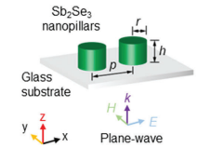
FABRICATION PROCESS PLAN

Slide 8
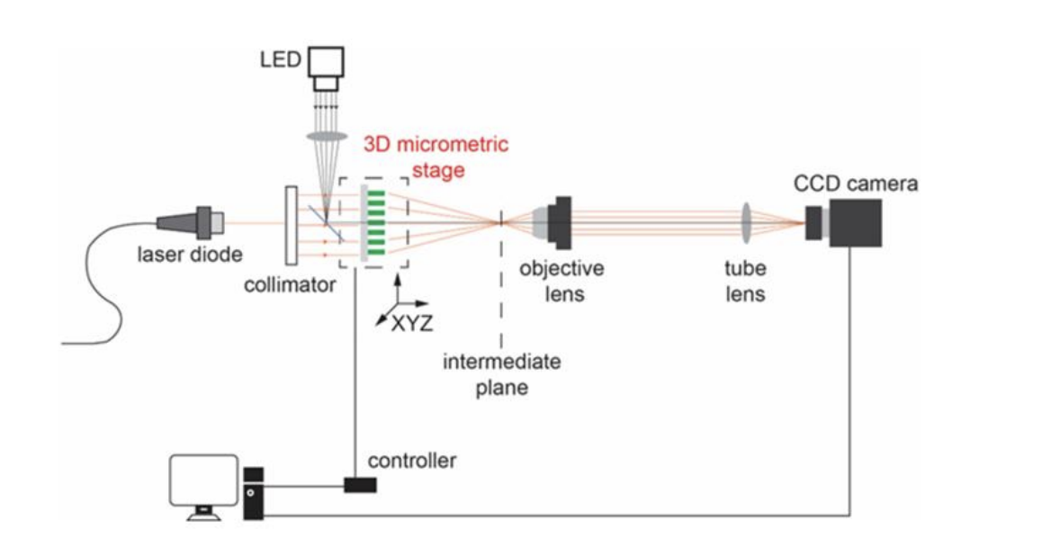
Illustration of the measurement setup for measuring focal points
Optical Characterization: The optical measurement was conducted using a customized microscope system .The sample was placed on a piezo-motorized scanning stage.
The near-IR (1570 nm) laser was (Keysight, N7711A) propagated onto the sample through a 0.28-NA objective lens.
The 2D light-intensity images were recorded by a digital CCD camera.
The longitudinal light intensity distribution through the meta lens was acquired through a stack of 2D images by scanning the meta lens position along light propagation direction (z-axis) with a step size of 200 nm.
The stage movement and data acquisition were controlled by an open source program (μmanager). The focusing efficiency was normalized by the transmitted intensity through a bare glass substrate measured under the same setup.

Slide 9

FLOW CHART

Slide 10
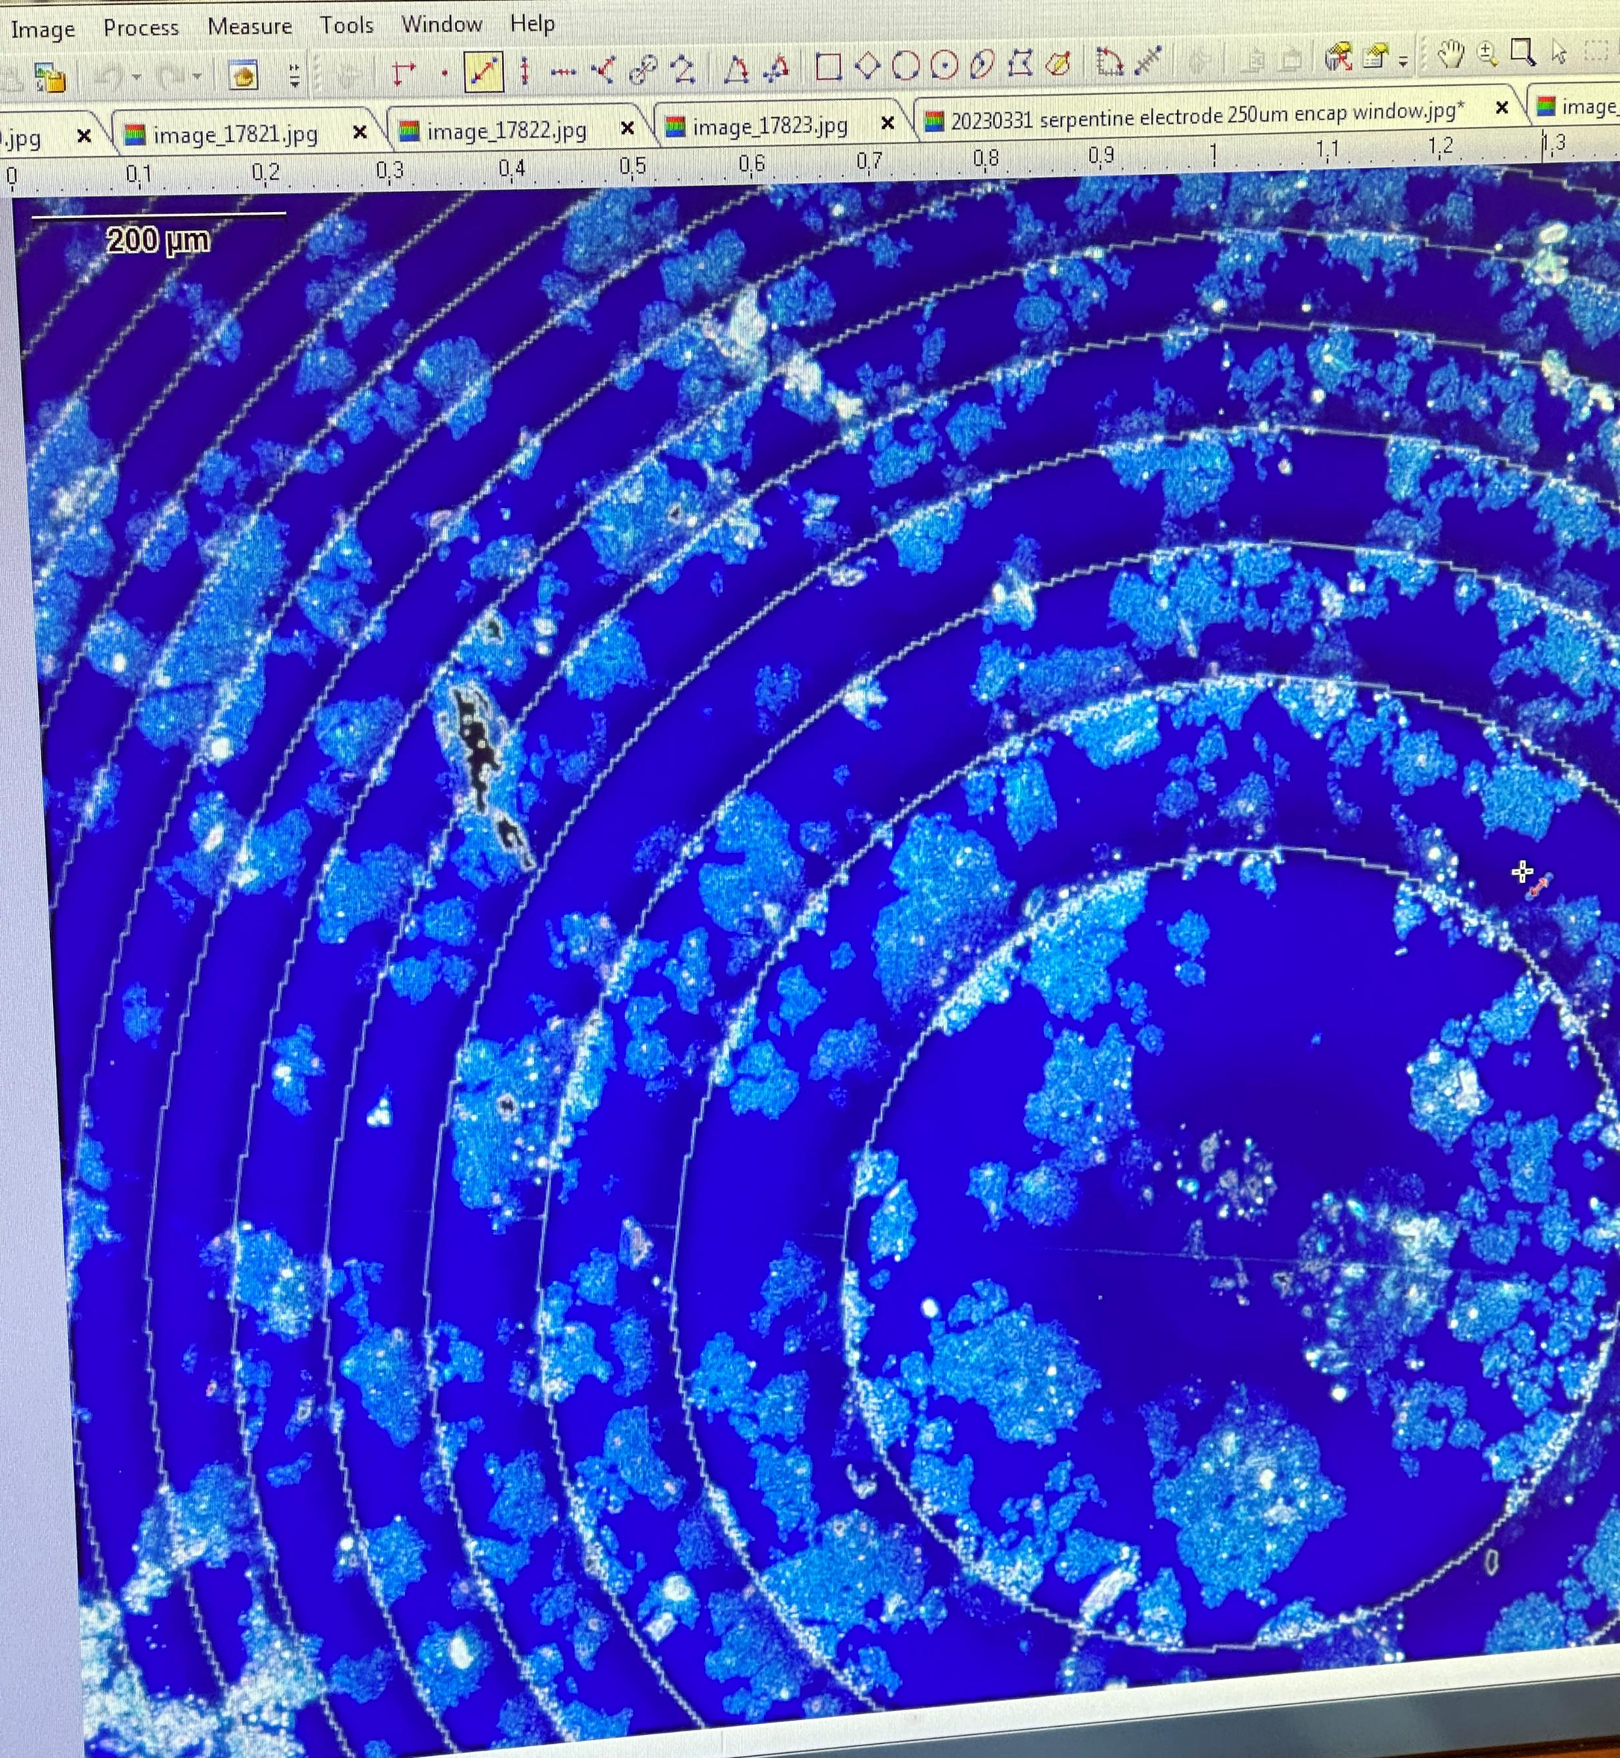
GEN 1
The base dose is 700. The beam current is noted to be 0.255 nA.
After the design is fabricated, we used MF319 as the developer and followed by DI water for 90 sec and observed the meta lens using optical microscope.
We have etched around 300nm of PCM and ITO layer for about 100 sec.
We observed and obtained the SEM images.

Slide 11
LEARNING GEN1
The SEM image was observed with a tilt of 45 degrees and 30 degrees to check the thickness of the etched PCM and ITO.
The Etc

Slide 12
GEN 2
Using a different dose: 500 and 1000
The base dose is 500 and 1000. The beam current is noted to be 0.2549 nA.
Etching process.
We have etched around 300nm of PCM and ITO layer for about 100 sec.
We observed and obtained the SEM images.

Slide 13
LEARNING GEN2
We then measured the thickness of the amount of PR etched.
From the below graph in the profilometer, we can observe that we have etched around 350 nm (which includes 300nm of photoresist and some part of PCM).
So, our etch rate is 350/90=3.88nm/sec.
Since the profilometer cannot measure the height of the pillar as the neighboring distance between two pillars is small, we have fabricated two squared beside the meta lens and easily found etch rate using a profilometer.

Slide 14
GEN 3
Considering thickness as the parameter, we have increased the thickness of the PCM by 200nm and the dose is 750 and 850.
The base dose is 750 and 850. The beam current is noted to be 0.25375 nA.
Etching process.
We have etched around 300nm of PCM and ITO layer for about 100 sec.
We observed and obtained the SEM images.

Slide 15
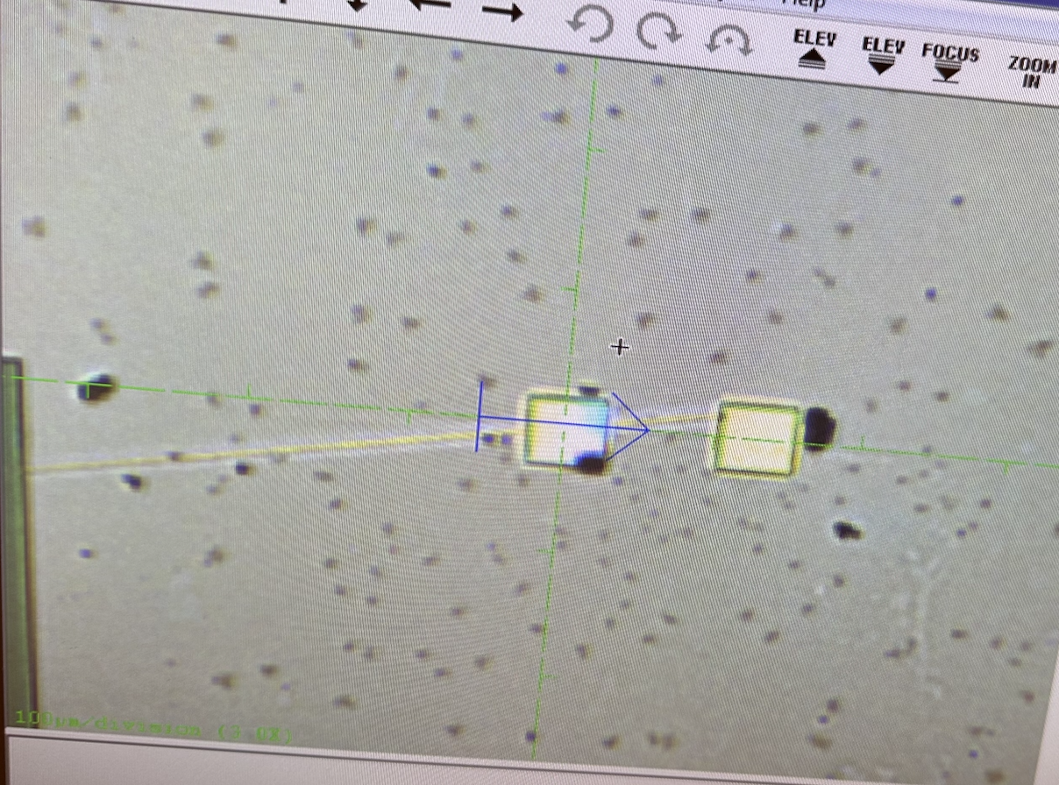
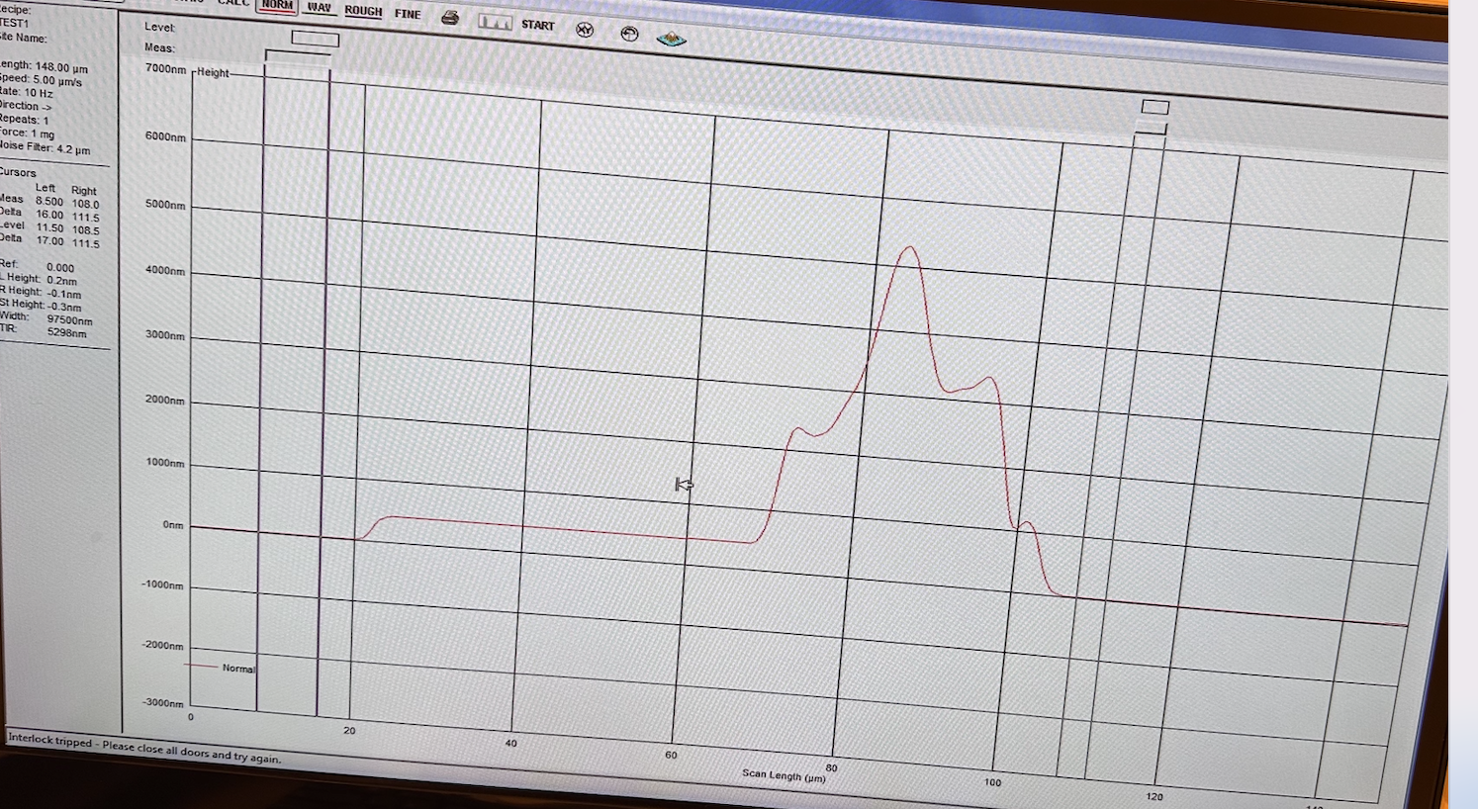
LEARNING GEN3
We then measured the thickness of the amount of PR etched.
From the below graph in profilometer, we can observe that we have etched around 350 nm (which includes 300nm of photoresist and some part of PCM).
So, our etch rate is nm/sec.

Slide 16
RESULTS/COMPARISON
 | DOSAGE | ETCH RATE | Height of nano pillar | Thickness of PCM
GEN 1 | 700 |  |  | 300nm
GEN 2 | 500 and 1000 |  |  | 300nm
GEN 3 | 750 and 850 |  |  | 450nm

Slide 17
CHALLENGES
We could not check the thickness using the profilometer for Gen 1 fab.
We could not see the 500 dose structure.
In Gen 2, -ve PR that we used expired, but our dose 1000 device was successful observed.
In the structure the cells had a dose factor of 0 and hence we could not see the complete structure.

Slide 18
DISCUSSION

Slide 19
REFERENCES
Bai, W., Yang, P., Huang, J. et al. Near-infrared tunable metalens based on phase change material Ge₂Sb₂Te₅. Sci Rep 9, 5368 (2019).
S. Qin, N. Xu, H. Huang, K. Jie, H. Liu, J. Guo, H. Meng, F. Wang, X. Yang, and Z. Wei, "Near-infrared thermally modulated varifocal metalens based on the phase change material Sb2S3," Opt. Express 29, 7925-7934 (2021).
Jiawei Meng, Nicola Peserico, Yaliang Gui, Haoyan Kang, Hamed Dalir, Behrouz Movahhed Nouri, Volker J. Sorger, "Reconfigurable focusing and defocusing meta lens using Sb2Se3 phase change material," Proc. SPIE 12432, High Contrast Metastructures XII, 1243203 (15 March 2023).
X. Yang, D. Zhang, S. Wu, Y. Yin, L. Li, K. Cao, K. Huang, Sci. Rep. 2017, 7, 1; b) S. Zahra, L. Ma, W. Wang, J. Li, D. Chen, Y. Liu, Y. Zhou, N. Li, Y. Huang, G. Wen, Front. Phys. 2021, 8, 593411; c) A. Afridi, J. Canet-Ferrer, L. Philippet, J. Osmond, P. Berto, R. Quidant, ACS Photonics 2018, 5, 4497; d) H.-S. Ee, R. Agarwal, Nano Lett. 2016, 16, 2818; e) E. Arbabi, A. Arbabi, S. M. Kamali, Y. Horie, M. Faraji-Dana, A. Faraon, Nat. Commun. 2018, 9, 1

Slide 20
THANK YOU

